Slide 1


Effect of Different Nose Profiles on Subsonic Pressure Coefficients
Ryan Felkel
Department of Mechanical and Aerospace Engineering
California State University, Long Beach
AIAA Student Research Conference Region VI
San Diego, CA
March 24 – 26, 2011

Slide 2
Outline
Problem Description
Pressure Gradients
Munk Airship Theory
Critical Pressure Coefficient
Karman-Tsien Compressibility Correction
Minimum Pressure Coefficient
Critical Mach Number
Summary

Slide 3
Problem Description
Sounding rockets at high angle of attack shed a vortex pair from the forebody boundary layer
  Especially when roll rate = pitch natural frequency … called roll resonance, a high angle of attack flight condition
  Vortex pair induces a rolling moment
  Vortex-induced roll moment overrides both roll damping and driving (due to fin cant) torques
  Result is prolonged resonance, very high angles of attack, excessive drag and sometimes structural failure

Slide 4
Problem Description, cont.
Boundary separation usually associated with an adverse pressure gradient ~ pressure increasing downstream
  Familiar examples
    Stalled wing
    Behind a shock wave
    Leeward side of a bluff body
Low Pressure
High Pressure

Slide 5
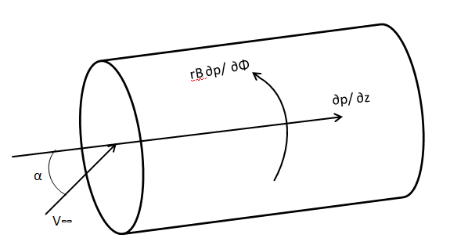
Pressure Gradient Components
Circumferential Pressure Gradient (rB ∂p/∂Φ)
  Flow around the body
  Induced by angle of attack (α)
  Unavoidable situation
Longitudinal Pressure Gradient (∂p/∂z)
  Flow along the axial frame of reference
  Mitigation possible

Slide 6
Nose Profiles
Three nose shapes were analyzed: Cone, Ogive, and Optimum
Fineness ratio of 6 (L = 36”, D = 6”)

Slide 7
Munk Airship Theory
Process used to calculate pressure along an elongated airship with circular cross section
Points along the body station can be treated as three-dimensional source flows
Vector R is a position vector from a point along the body station axis to an off axis point
R moves along the surface of the nose to estimate the incompressible pressure coefficient acting on zi, which is the sum of all pressure coefficients with different R vectors
Different “zi”s are used to generate a Cp profile
VR
r
R
zi
z
Munk Airship Theory is used to derive an equation for incompressible pressure coefficients based on source flow. (Derivation of equation found in paper.)

Slide 8
Munk Airship Theory Results
Fineness ratio of 6 (L = 36”, D = 6”)

Slide 9
Critical Pressure Coefficient
Isentropic relation between P∞ and P* (M=1)
Relation is plugged into the Cp equation with respect to free stream Mach number
Pressure Coefficient = (P*- P∞)/q

Slide 10
Karman-Tsien Compressibility Effects
Optimum nose L= 36”, D= 6” cylindrical afterbody
Incompressible pressure distribution from Munk Theory

Slide 11
Critical Mach Number Determination
Critical Mach number for the nose cone occurs when critical pressure coefficient function and Karman-Tsien function intersect.
Critical Mach Number (M=0.95)

Slide 12
Minimum Incompressible Pressure Coefficient

Slide 13
Critical Mach Number

Slide 14
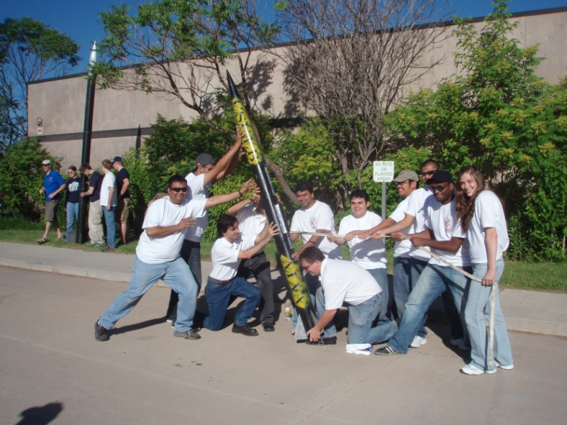
Summary
Procedure was created to analyze different nose profiles with different fineness ratios
Mitigation of longitudinal pressure gradients
Can be used for any continuous nose shape
The Experimental Sounding Rocket Association (ESRA) from CSULB will use this analysis for the 2011 Intercollegiate Rocket Engineering Competition (IREC) to design a nose for our bird, Gold Rush III

Slide 15
Pressure Coefficient
Pressure coefficient :
P = Pressure
V = Velocity
Use Bernoulli’s Law for pressure:
Local Velocities can be found by solving LaPlace’s equation
  Since Laplace’s equation is linear, can superpose solutions
  Axial flow and cross flow solutions obtained separately and then combined
Evaluate velocity components on a body surface
  Assume no boundary layer separation (e.g., α << 1)
  Axial flow solution
    Free stream velocity =
    Tangency condition implies Vr =
    Use Munk Theory for Vz
    Circumferential symmetry implies Vθ = 0

Slide 16
Pressure Coefficient, Cont’d
Cross flow solution
  Free stream velocity =
  For a slender body, Vz = 0
  Tangency condition implies Vr = 0
  Circumferential velocity from doublet solution:
Full pressure coefficient on surface of a slender body (drB/dz << 1)
This leads to plots shown at the bottom of chart #3

